Slide 1

Windows Forms: Introduction to Writing Custom Controls
Shawn Burke
Mark Boulter
.NET Frameworks
Microsoft Corporation

Slide 2

Introduction
The Windows Forms Framework
Windows Forms & GDI+
Building a sample control
  Paint it!
  Modify it! (Properties)
  Hear From it! (Events)
  Use it!
Collection properties
Wrap up

Slide 3
What’s The Big Deal?
CLR allows developers to concentrate on their code – GC, language agnostic, native interop, security.
Common design patterns between Windows Forms, WebForms, System.Net, etc.
No more code templating!
Rich, extensible design time support
Simplicity! No more headers, IDL, libs, obj, etc.
Web aware, data aware
Real, rich runtime type information

Slide 4
Windows Forms Controls Principles
Controls are Modeless
Hide complexity where ever possible while maintaining functionality
Common design patterns
Discoverable Functionality
One way to do things
Multilanguage – functionality accessible from any CLS language

Slide 5
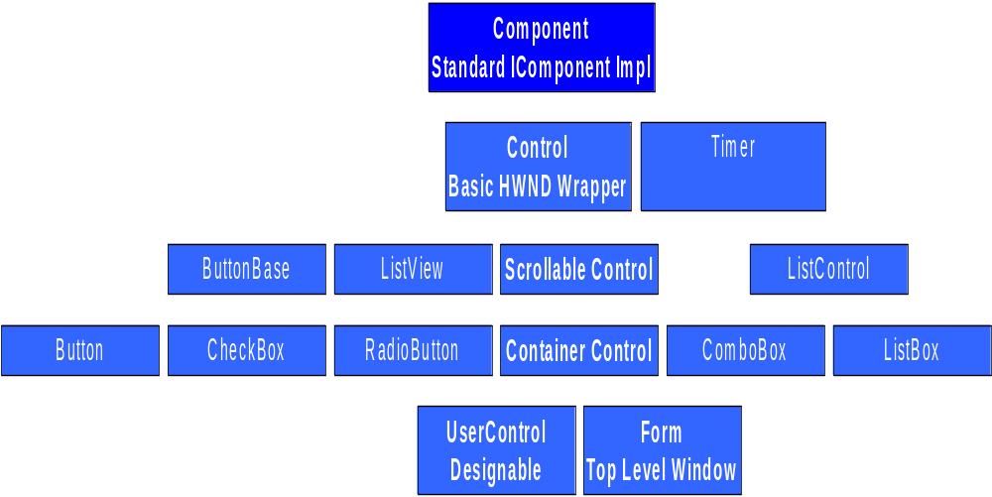
The Windows Forms Hierarchy

Slide 6
IComponent & Component
IComponent
  Provides hookup for a site
  Prerequisite for an object to participate in design time
Component
  Standard implementation of IComponent
  All .NET Framework components are based on Component
  Contains an Events property for event lookup

Slide 7
Control
  Basic HWND wrapper
  Handles majority of WM_* messsages
  Events for user input, painting, layout.
  Surfaces ActiveX® implementation
  Manages handle recreation
  Can expose HWND through Handle Property
  Can handle any Windows message by overriding the WndProc() member method.

Slide 8
ScrollableControl & ContainerControl
ScrollableControl
  AutoScrollMinSize property defines scrolling size
ContainerControl
  Manages focus of child controls
  Exposes ScrollableControl functionality
  Analogous to Windows Dialog Manager

Slide 9
Root Designable Types: UserControl & Form
UserControl
  Base type for compound controls
  Hides child controls
Form
  Windows Forms top-level control
  Has properties for system menus, minimize/maximize buttons, menus, etc.

Slide 10
Introduction to GDI+
Fully object oriented
GDI+ object can interoperate with GDI objects
Stateless – drawing object must be supplied with operation
Advanced features: anti-aliasing, textures & gradients, text effects, alpha blending

Slide 11
The Basics of Using GDI+
Base object is System.Drawing.Graphics
  Obtained from Control.Paint event or from Control.CreateGraphics
  Analogous to an HDC
Objects will clean up when finalized, but it’s a good practice to Dispose them when finished with them – Win9x platforms can make this mandatory!
Standard objects in SystemColors, SystemBrushes, SystemIcons, SystemPens
ControlPaint encapsulates common operations

Slide 12
Simple GDI+ Operations
Draw some text
  Graphics g = someCtl.CreateGraphics();
  g.DrawString(“Hello World!”, someCtl.Font, SystemBrushes.WindowText,0,0);
  g.Dispose();
Draw a green circle
  Graphics g = someCtl.CreateGraphics();
  Brush b = new SolidBrush(Color.Green);
  g.FillEllipse(b, 0, 0, 100, 100);
  b.Dispose();
  g.Dispose();

Slide 13
GDI+: Getting Fancy
Paint a bitmap onto an area, wash it out
  Image img = new Bitmap(“myimage.bmp”);
  TextureBrush tBrush = new TextureBrush(img);
  Brush washBrush = new SolidBrush(Color.FromArgb(180, Color.White));
  g.FillRectangle(tBrush,0,0, 100, 100);
  g.FillRectangle(washBrush,0,0, 100, 100);
  tBrush.Dispose();
  washBrush.Dispose();
  img.Dispose();

Slide 14
DEMO
GDI+

Slide 15
Properties
Properties are “smart fields”
  Natural syntax and accessors
public class Button: Control {
private string text;
public string Text {
get {
return text ;
}
set {
text = value;
Repaint();
}
}
}
Dim b As New Button
b.Text = "OK"
Dim s As String = b.Text

Slide 16
Using Delegates For Events
Declare the delegate type
    public delegate void SampleDelegate(object sender, string info);
Declare your event
    public class DelegateSampleServer {
    public event SampleDelegate Sample;
    protected virtual void FireSample () {
    if (Sample != null)
    Sample(this, "Hello Delegate!");
    }
    }
Notes:
SLOW DOWN!!!!! WATCH YOUR CANTER!!!
Point out the event keyword
Point out the invocation syntax

Slide 17
Using Delegates, Continued
Sink the event
    public class SampleDelegateClient {
    public void SinkDelegate(DelegateSampleServer ds){
    ds.Sample += new SampleDelegate(this.OnSampleDelegate);
    }
    private void OnSampleDelegate(object sender,
    string info) { Console.WriteLine("Sample Fired: '" +
    info + "'");
    }
    }
Notes:
SLOW DOWN!!!!! WATCH YOUR CANTER!!!
Point out multiple events can point at same Handler with Handles button1.Click, button2.Click

Slide 18
Implementing a Control From Scratch
We’ll build an Alarm Clock Control
Derives from Control
First get the runtime working, then extend the design time

Slide 19
Custom Controls
Eventing through overrides rather than delegates
Access protected methods on base classes
May need to add support for additional Windows notifications
Built just like the included Windows Forms controls

Slide 20
Extending Existing Window Types
Control.CreateParams property allows you to customize the underlying CreateWindowEx call
  Example System.WinForms.Button
  private const int BS_PUSHBUTTON = 0x0;
    private const int BS_OWNERDRAW = 0xB;
    protected CreateParams CreateParams {
    override get {
    CreateParams cp = base.CreateParams;
    cp.ClassName = "BUTTON";
    cp.Style |= BS_PUSHBUTTON;
    cp.Style |= BS_OWNERDRAW;
    return cp;
    }
    }

Slide 21
Override the OnPaint Method
Derived classes can handle painting by overriding Control’s OnPaint method
    protected override void OnPaint(
    PaintEventArgs pe) {
    pe.Graphics.FillRectangle(
    new SolidBrush(this.BackColor), this.ClientRectangle);
    pe.Graphics.DrawString(this.Text, this.Font,
    new SolidBrush(this.ForeColor), ClientRectangle);
    }
Call base.OnPaint(pe) if you want to execute the default painting logic as well

Slide 22
Demo
Painting the Alarm Clock

Slide 23
Add Properties & Methods
Add the properties & methods that make sense for your control
Be careful what you make virtual, public. If people can call it, they will!
Be sensitive to handle creates and recreates
  Control.IsHandleCreated
Try to keep your control modeless when possible
Caveat: Value types vs. reference types
Use Collections instead of arrays

Slide 24
Add Events
Events can use built in field or getter and setter like a property
  Built-in creates a member variable – with lots of events this can bloat your instance size.
  Component exposes an Events property for hashing EventHandlers
  private static readonly object EventFoo = new object();
  public event EventHandler Foo {
  get {
  return base.Events[EventFoo];
  }
  set {
  base.Events[EventFoo] = value;
  }
  }

Slide 25
Add Events, Continued
Events should have corresponding protected virtual On<Event Name> invoking function
  protected virtual void OnFoo(EventArgs e) {
  EventHandler fooHandler = this.Foo;
  if (fooHandler != null) {
  fooHandler(this, e);
  }
  }
Derived classes should call base.On<Event Name> to allow event firing.

Slide 26
Demo
Adding Events & Properties to the Alarm Clock

Slide 27
Using Collection Properties
Windows Forms uses Collection properties instead of array properties
  ListBox.Items
  ListView.Columns
  Toolbar.Buttons
  Control.Controls
Collections avoid extra array creations and allow value changes to be reflected after value is fetched
Modifiable Collection properties should implement System.Collections.Ilist
Collection properties should never return null, but rather an empty collection!

Slide 28
Demo
Adding a Collection Property to the Alarm Clock

Slide 29
Sub-Object Properties
Don’t have to be IComponents
Can be reference or value
  Example: Control.Size, Label.Image
Won’t show up on design surface
Should be used sparingly

Slide 30
Just In Case: Access to the Underlying System
Control has a Handle property that returns the Controls HWND
  Caveat: If the HWND hasn’t been created, it will create one!
You can get an HDC from the Graphics object
Controls have a protected virtual WndProc method
Notes:
SLOW DOWN!!!!! WATCH YOUR CANTER!!!

Slide 31
Access to the System, Continued
Example of overriding the Window Procedure to catch a message:
  private const int WM_COMPACTING = 0x041;
  protected override void WndProc(ref Message m) {
case (m.msg) {
case WM_COMPACTING:
OnCompacting();
break;
}
base.WndProc(m);
}
Notes:
SLOW DOWN!!!!! WATCH YOUR CANTER!!!

Slide 32
Metadata And Attributes
How do you define additional information about a class?
[
Category("Appearance"),
Description(“Text describing property"),
DefaultValue(“OK”),
Bindable(true)
]
public string Text {
....
}
}

Slide 33
Some Interesting Attributes In .NET Frameworks
All .NET Frameworks Attributes Derive from System.ComponentModel.MemberAttribute
  BrowsableAttribute
  BindableAttribute
  CategoryAttribute
  DefaultEventAttribute/DefaultPropertyAttribute
  DesignerAttribute
  LicenseProviderAttribute
  MergablePropertyAttribute
  PersistableAttribute
  PersistContentsAttribute
  ShowInToolboxAttribute
  ToolboxItemAttribute

Slide 34
Demo
Add attributes to Alarm Clock Properties

Slide 35
Type Converters
Runtime and design-time
No dependency on any UI package
Base type:
  System.ComponentModel.TypeConverter
Enable:
  Type conversion (ConvertFrom, ConvertTo)
  Persistence (CreateInstance, PersistInfo)
  Custom properties
  Standard values
  Validity checking

Slide 36
Using Type Converters
Generic conversion:
private object StringToValue(string s, Type t) {
  TypeConverter tc = TypeDescriptor.GetConverter(t);
  if (tc != null & tc.CanConvertFrom(typeof(string))) {
  return tc.ConvertFromString(s);
  }
  return null;
  }
Demo: Standard Values Converter

Slide 37
Implementing Type Converters
Code is usually very simple
Associate with a Type using the TypeConverterAttribute
Get standard subproperties using TypeDescriptor.GetProperties
Example: Size & SizeConverter
Example: TypeConverters & The Property Browser

Slide 38
Property Editors
Editing UI for hosts
  Property Browsers, DataGrids
EditorAttribute enables multiple editors
  Extensible, however today we only have one type
System.Drawing.Design.UITypeEditor
  Used by the property browser

Slide 39
UITypeEditor
PaintValue
  Enables custom rendering for each value
  Example: Color Property
EditValue
  Enables Custom Editing UI
  Example: Color Picker

Slide 40
Demo
Different editor in Windows Forms
Clock with a TypeConverter and UITypeEditor

Slide 41
Wrap Up
Creating Windows Forms controls is easy
.NET Frameworks and Common Language Runtime are 100% devoted to Rapid Application Development
GDI+ simplifies and improves access to Control Drawing
Windows Forms won’t lock you out of advanced functionality

Slide 42
Questions?

